Slide 1





Receiver Temperature Estimates for
HERA H1C Observations
Tyler Cox
Advisors: Daniel Jacobs and Adam Beardsley
NASA Space Grant Symposium
April 13, 2019

Slide 2
Acknowledgements
I would like to extend my thanks to:
Danny Jacobs and Adam Beardsley
Shane Bechtel and Lily Whitler
Low-Frequency Cosmology (LoCo) Lab
ASU/NASA Space Grant Consortium
Without their contributions, this work would not have been possible

Slide 3
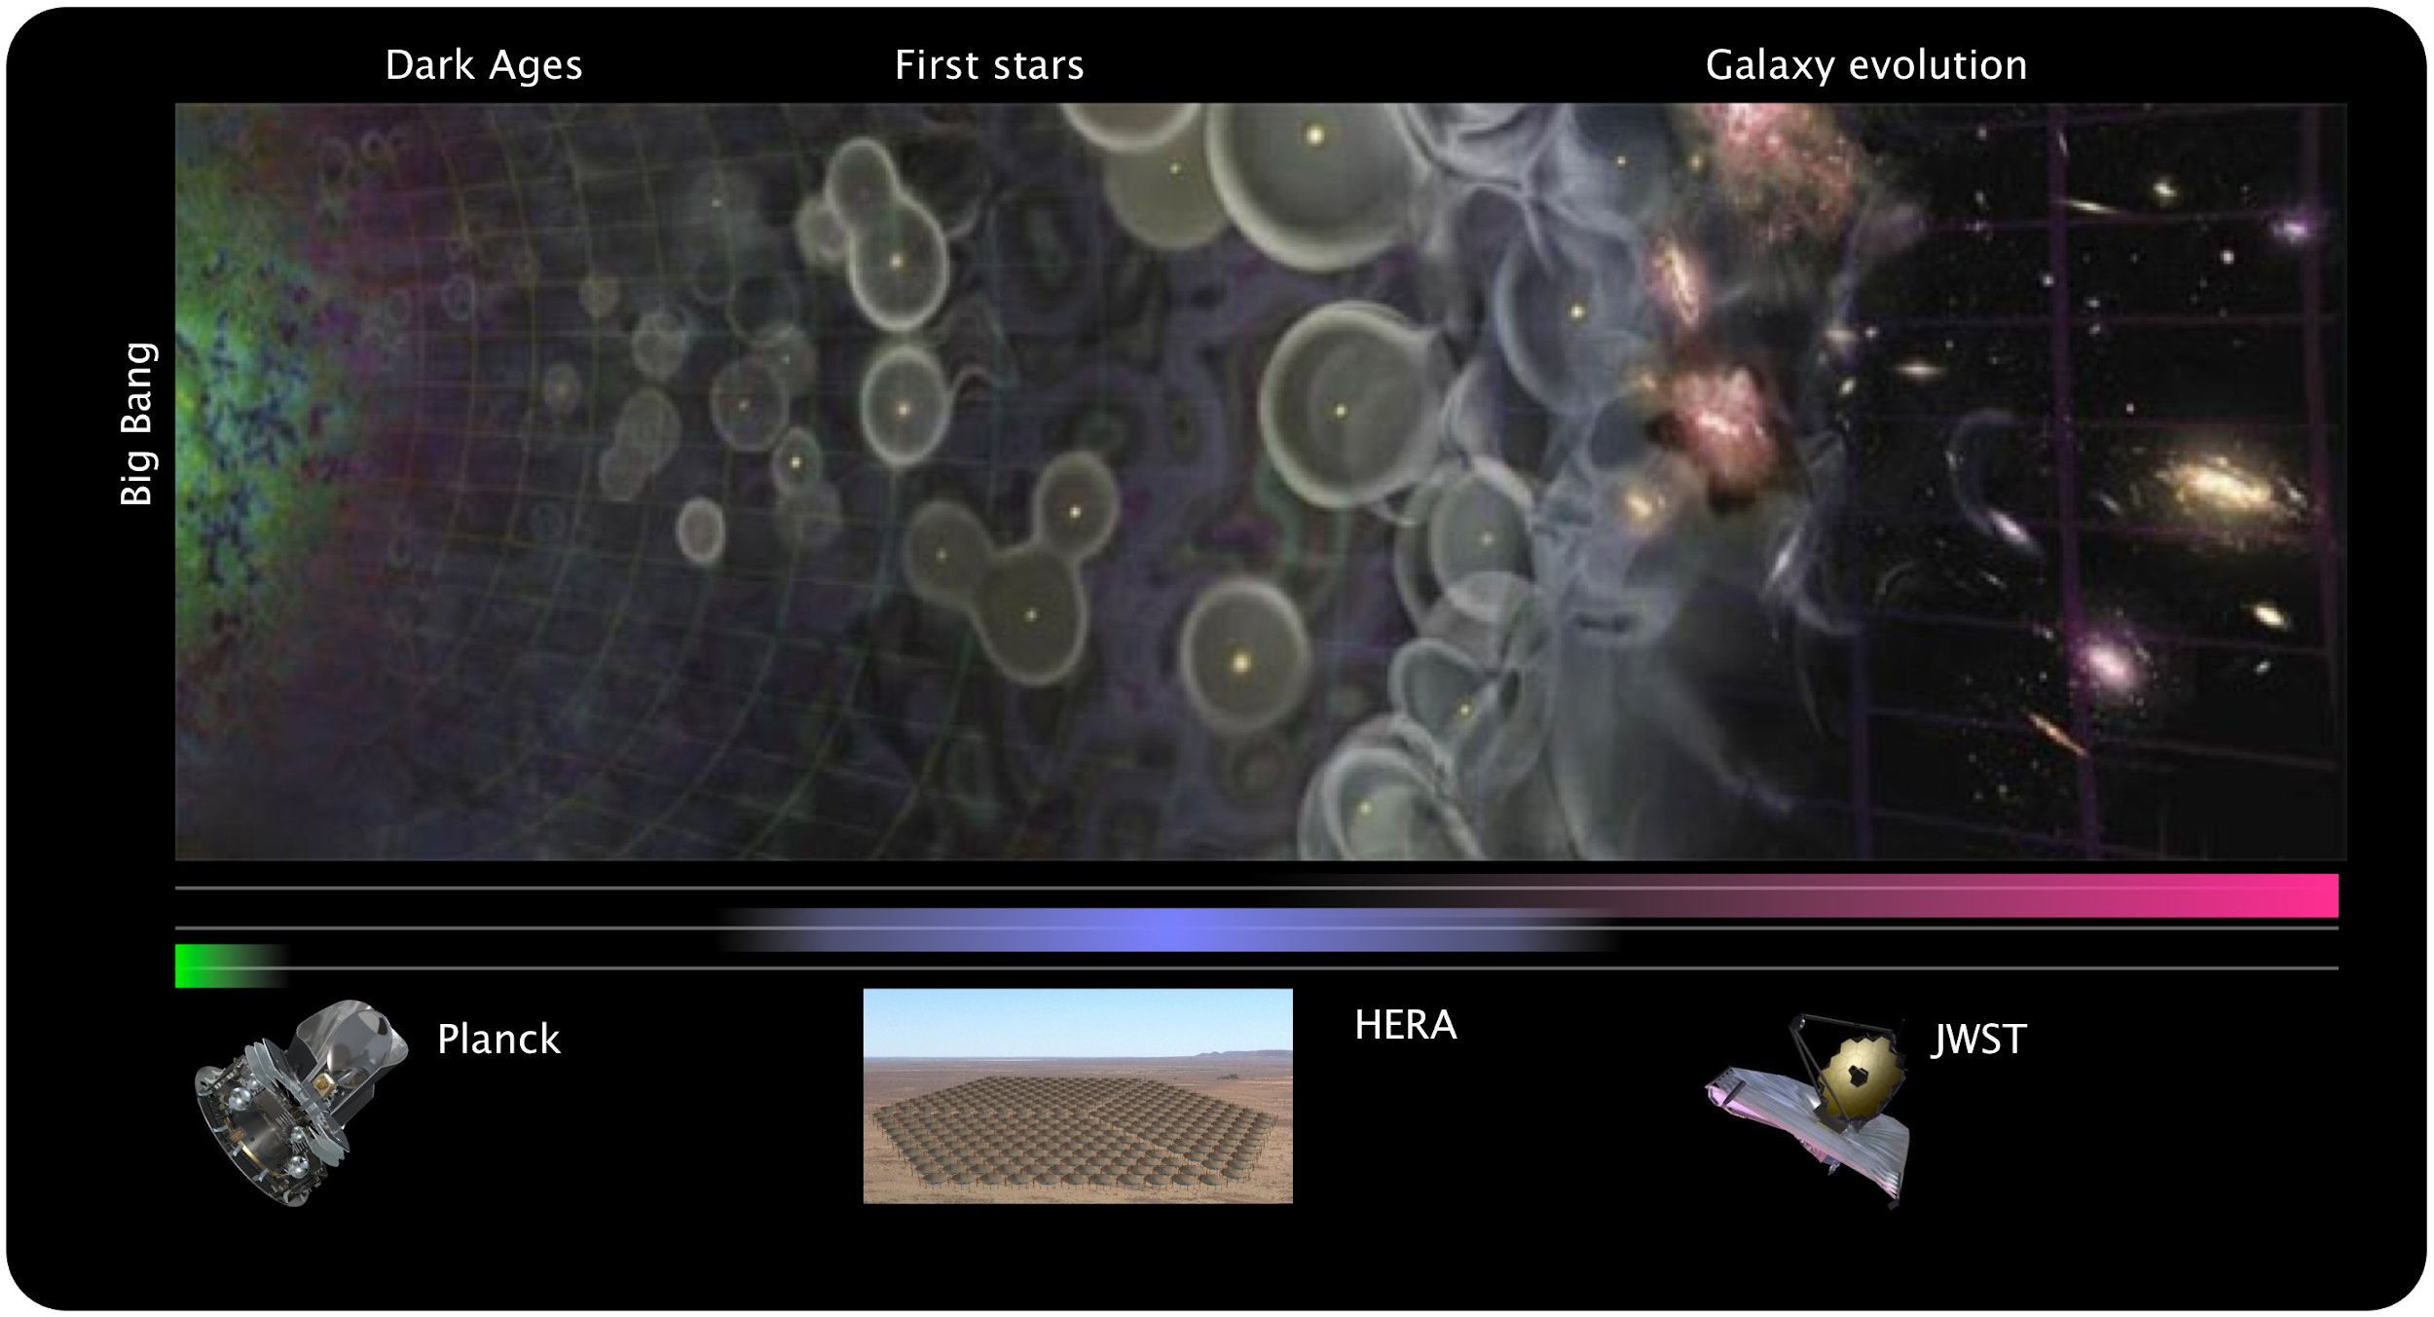
History of the Universe

Slide 4
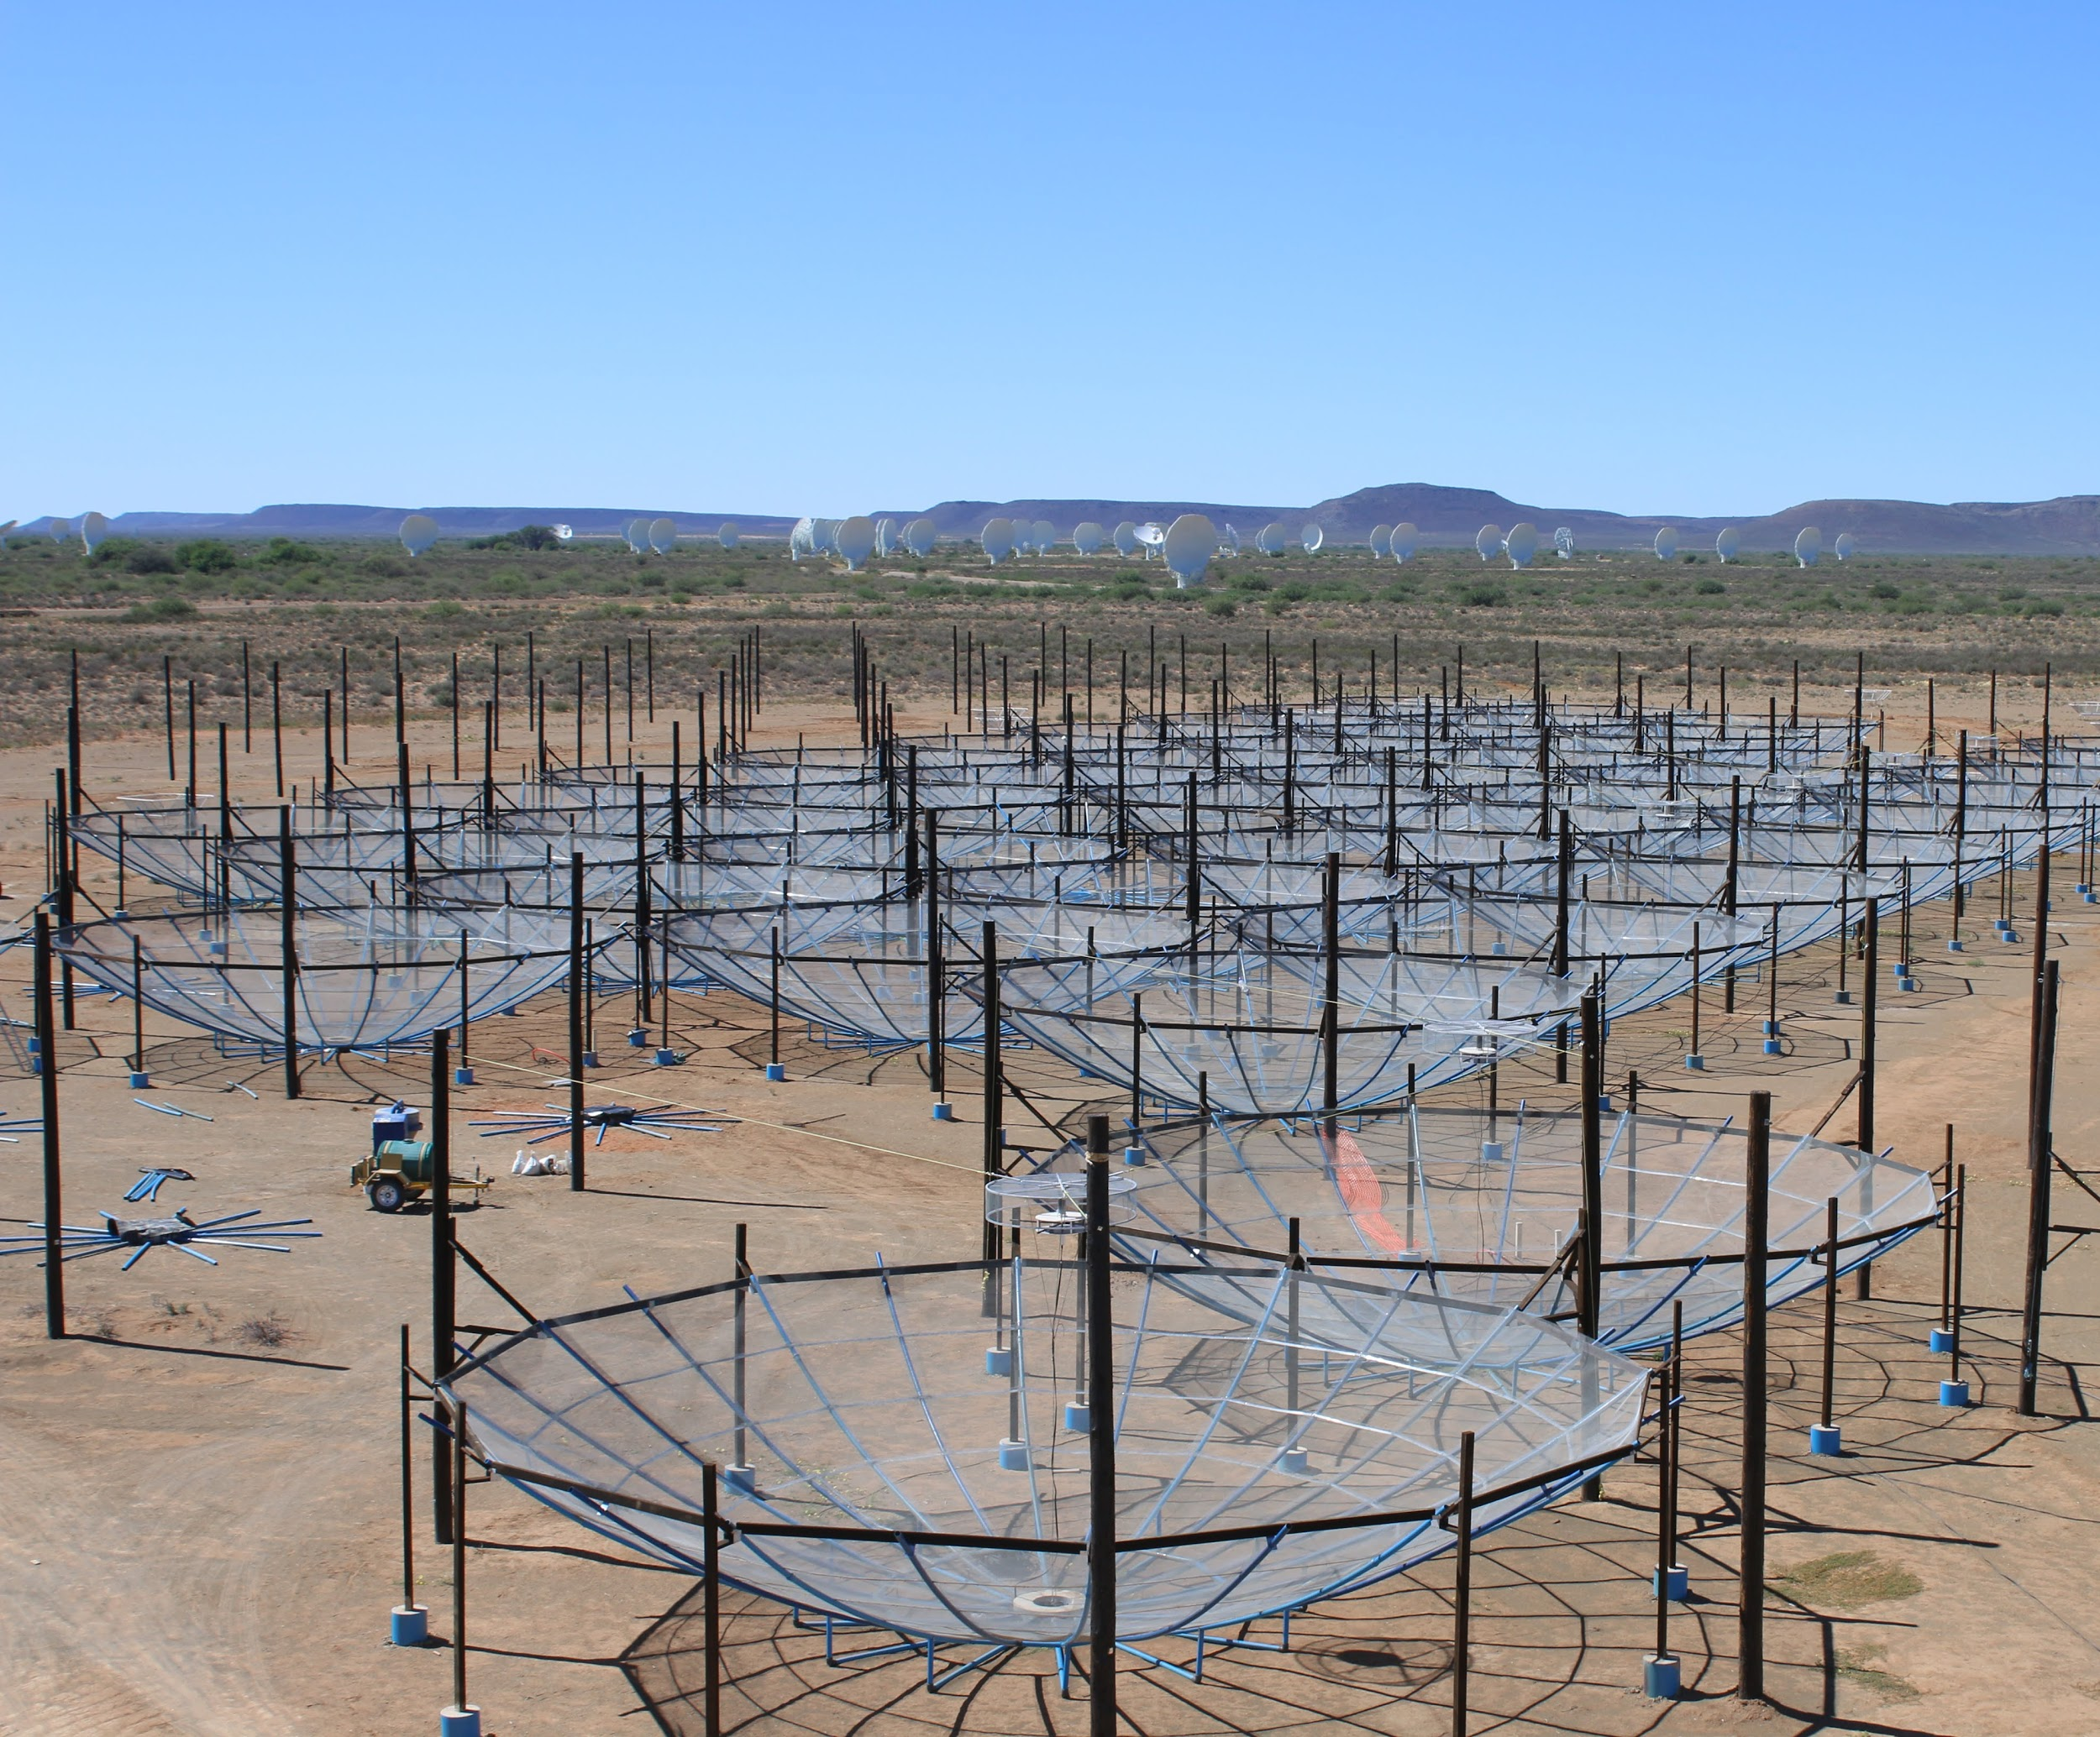
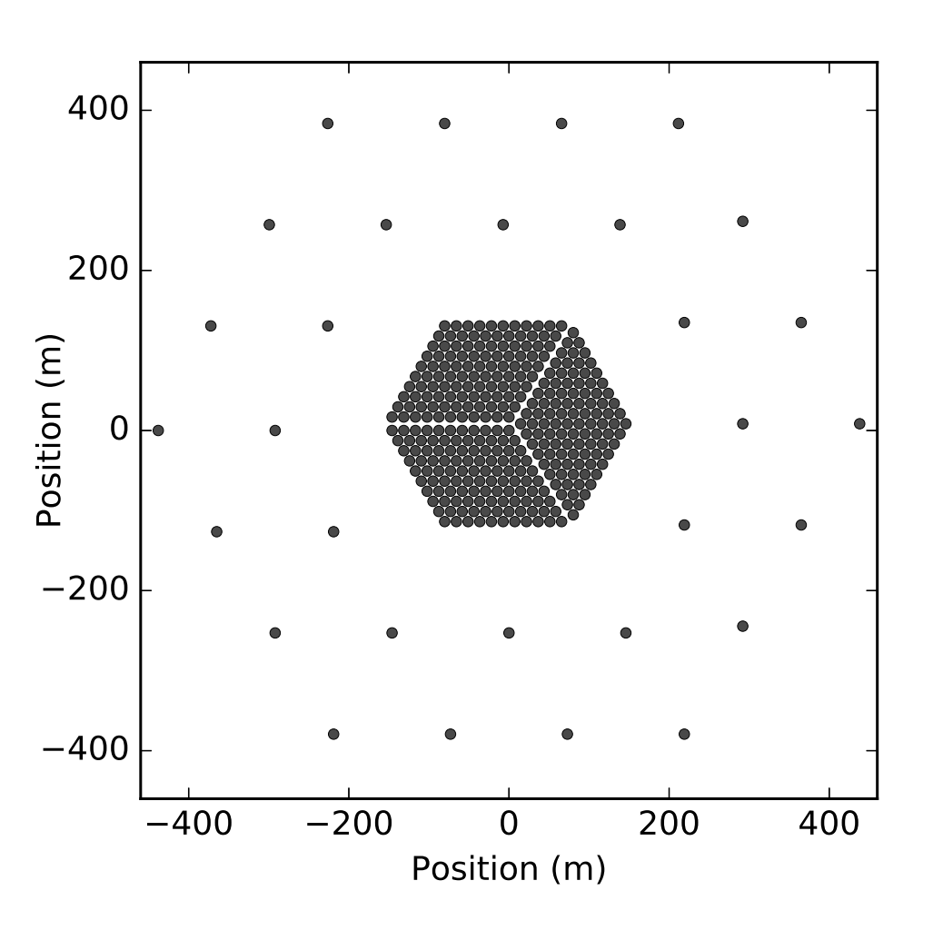
Hydrogen Epoch of Reionization Array (HERA)
The Hydrogen Epoch of Reionization Array is hosted by the South African Radio Astronomy Observatory, which is a facility of the National Research Foundation, an agency of the Department of Science and Technology.This material is based upon work supported by the National Science Foundation under Grant No. 1636646, the Gordon and Betty Moore Foundation, and institutional support from the
HERA collaboration partners.

Slide 5


Receiver Temperature
Receiver temperature is noise due to the receiver itself
The noise of HERA observations is proportional to the receiver temperature
Knowledge of the receiver temperature is necessary if we wish to know the sensitivity of HERA

Slide 6
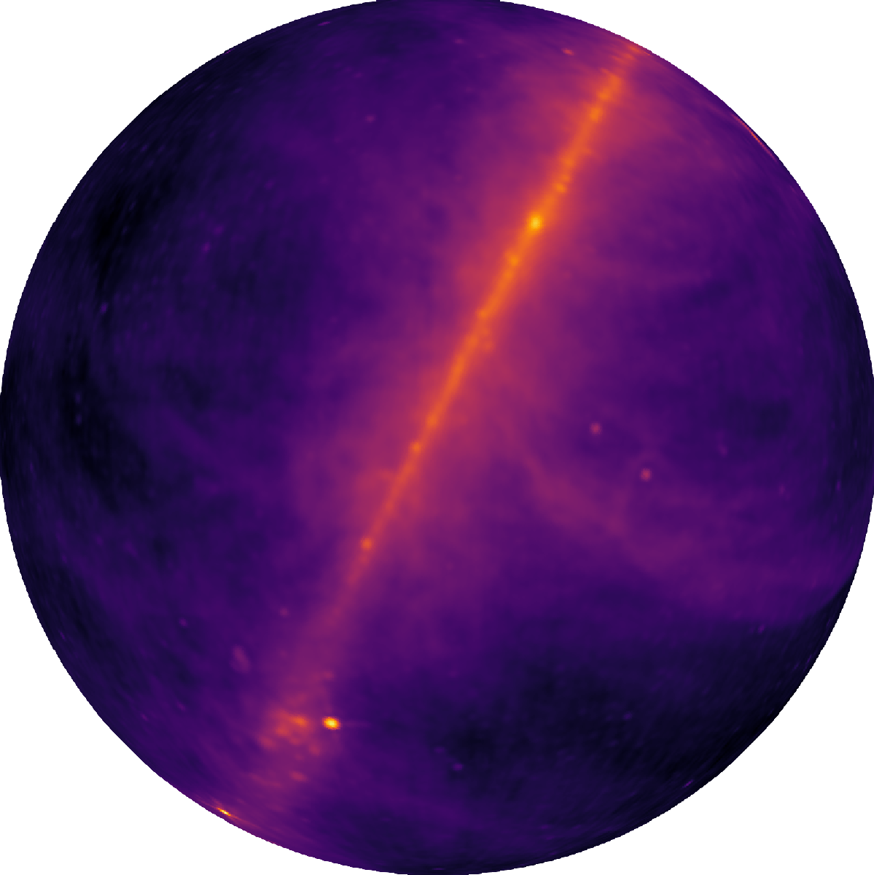
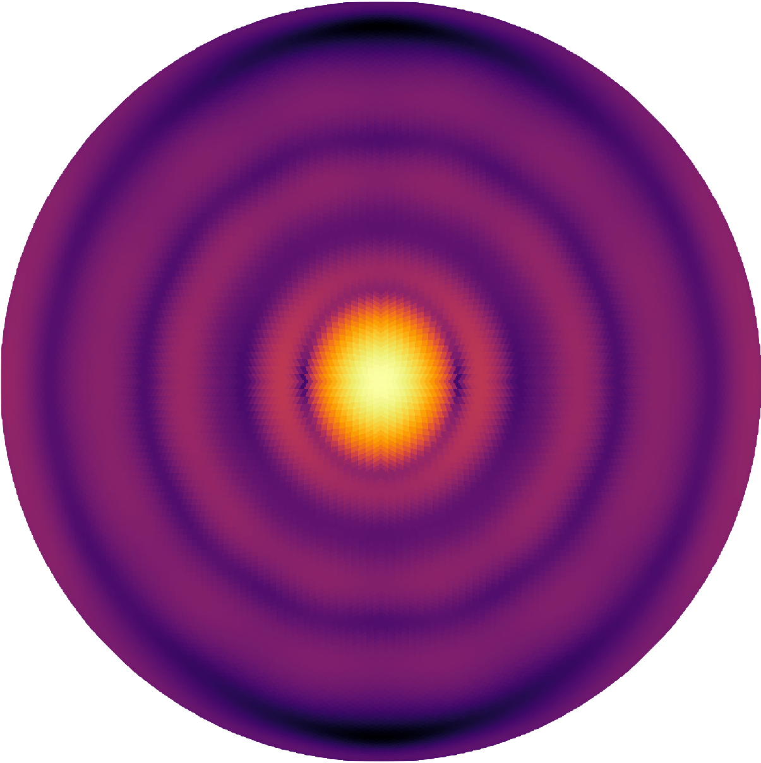
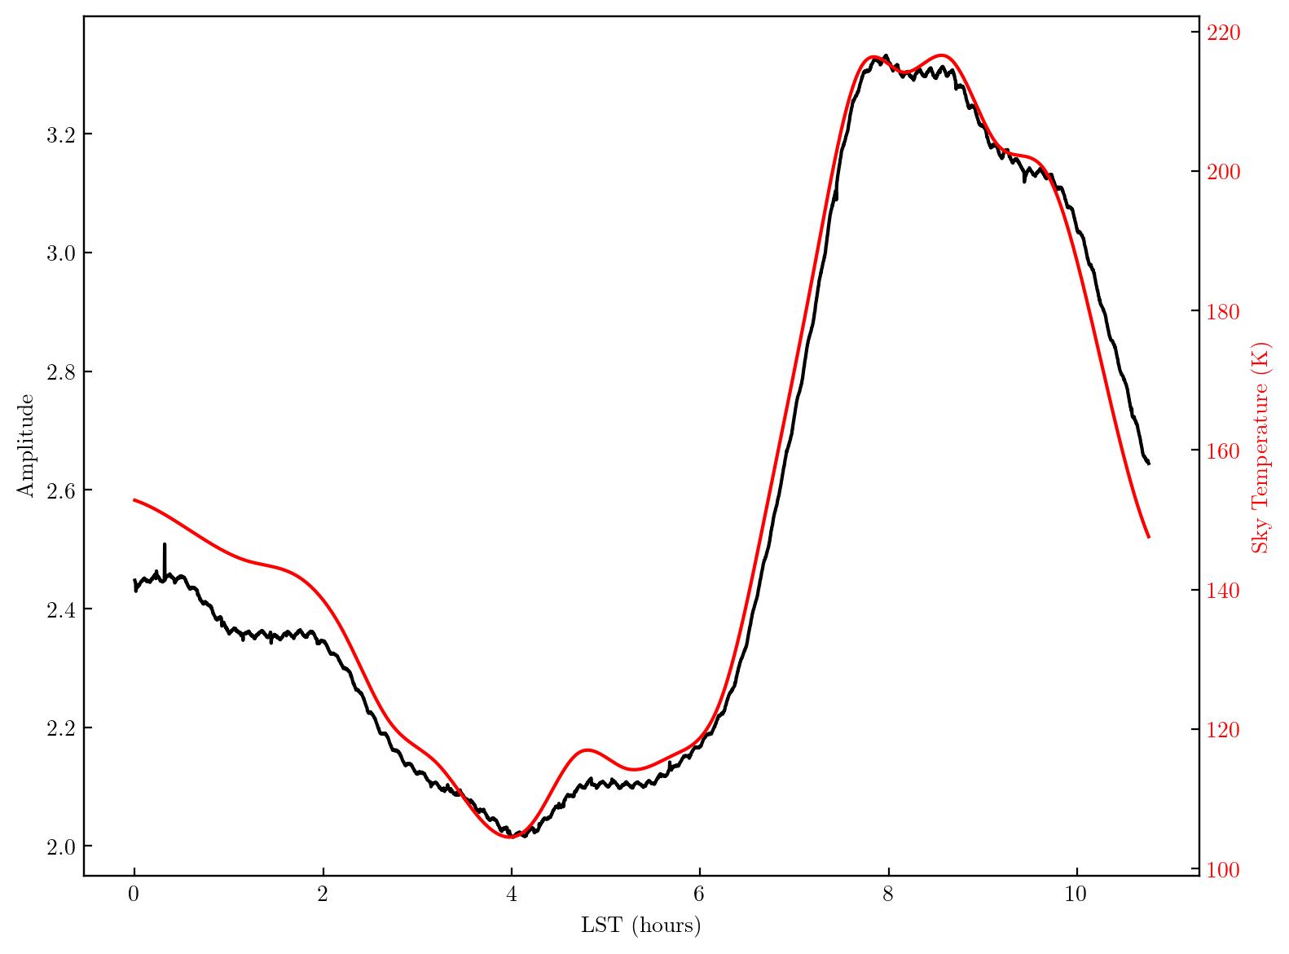
Modeling Data
Global Sky Model
HERA Beam Model
Model vs. Data

Slide 7
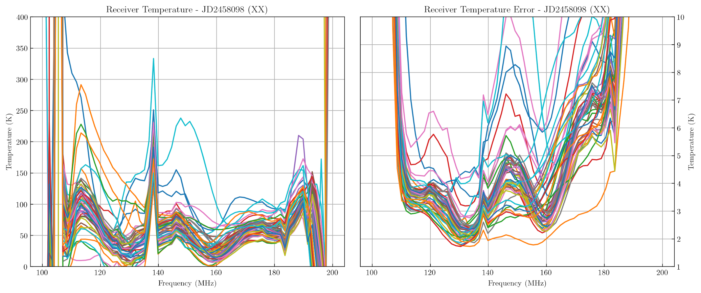
Receiver Temperature Estimates

Slide 8
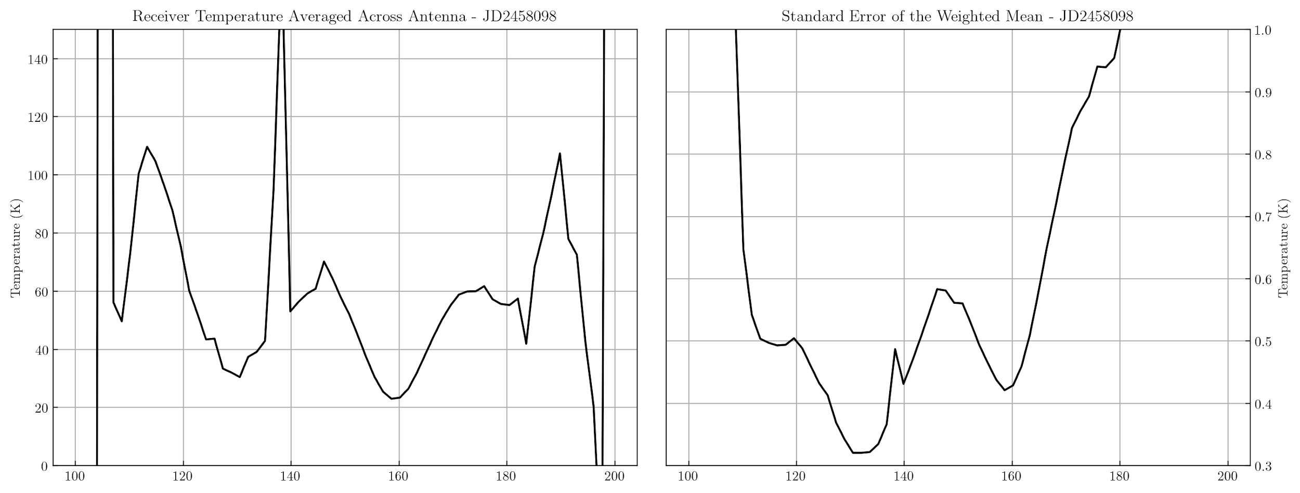
Receiver Temperature Estimates

Slide 9
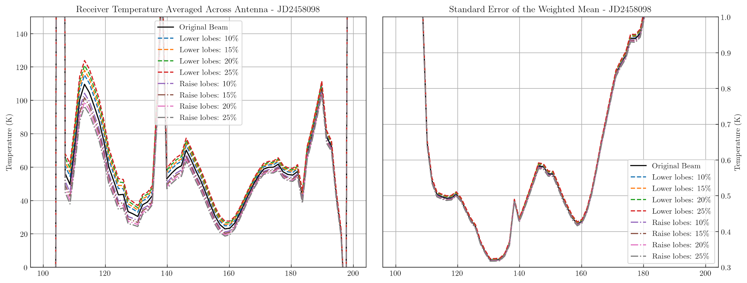
Uncertainty on Receiver Temperature Estimate

Slide 10
Summary
Receiver temperature estimates for H1C observations match theoretical estimates of the receiver temperature
Error bars seem to realistic with fractional error hovering around ~20%
Future work will include further error analysis (variance in the data, more beam/sky model uncertainty) to constrain the noise level of the array
Further Questions?
Tyler Cox
Email: tyler.a.cox@asu.edu

